Slide 1
Derivatives

Slide 2
Outline
What is a Derivative?
Rules of Derivatives

Slide 3

What is a derivative?
A derivative is a function that gives you the slope of some $x$

Slide 4
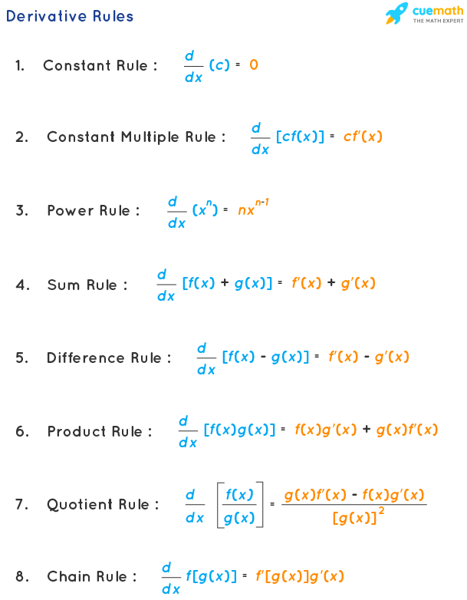



Derivative Rules
$$\frac{d }{d x}\left(c\right)=0$$
1. Constant rule:
2. Constant multiple rule:
$$\frac{d }{d x}[cf(x)] =cf′(x)$$
$$\frac{d }{d x}[x^{n}] =nx^{n−1}$$
3. Power rule:

Slide 5



Derivative Rules
4. Sum rule:
$$\frac{d }{d x}\left[f\left(x\right)+g\left(x\right)\right]=f′\left(x\right)+g′(x)$$
5. Difference rule:
$$\frac{d }{d x}\left[f\left(x\right)−g\left(x\right)\right]=f′\left(x\right)−g′(x)$$
6. Product rule:
$$\frac{d }{d x}\left[f\left(x\right) g\left(x\right)\right]=f\left(x\right)g^{′}\left(x\right)+g(x)f′\left(x\right)$$

Slide 6


Derivative Rules
7. Quotient Rule:
$$\frac{d }{d x}\left[\frac{f\left(x\right)}{g(x)}\right]=\frac{g\left(x\right)f^{′}\left(x\right)−f\left(x\right)g^{′}\left(x\right)}{{[g(x)]}^{2}}$$
8. Chain rule:
$$\frac{d }{d x}f\left[g\left(x\right)\right]=f^{′}\left[\left(g(x\right)\right] g′(x)$$

Slide 7

Constant Rule
$$\frac{d }{d x}\left(c\right)=0$$
The constant rule of derivatives states that the derivative of any constant is 0

Slide 8



$$\frac{d }{d x}\left(c\right)=0$$
1) $\frac{d }{d x}\left(5\right)=0$
2) $\frac{d }{d x}(−7) =0$

Slide 9

Power Rule
$$\frac{d }{d x}\left(x^{n}\right)=nx^{n−1}$$

Slide 10



$$\frac{d }{d x}\left(x^{n}\right)=nx^{n−1}$$
1) $\frac{d }{d x}\left(x\right)=1x^{1−1}={1x}^{0}=1x=x$
2) $\frac{d }{d x}\left(x^{2}\right)=2x^{2−1}={2x}^{1}$

Slide 11


$$\frac{d }{d x}\left(x^{n}\right)=nx^{n−1}$$
3) $\frac{d }{d x}\left(x^{3}\right)=3x^{3−1}={3x}^{2}$
4) $\frac{d }{d x}\left(x^{4}\right)=4x^{4−1}={4x}^{3}$

Slide 12

Constant Multiple Rule
$$\frac{d }{d x}[cf(x)] =cf′(x)$$

Slide 13




$$\frac{d }{d x}[cf(x)] =cf′(x)$$
1) $\frac{d }{d x}\left({4x}^{7}\right)=4 ×\frac{d }{d x}\left(x^{7}\right)$
$\frac{d }{d x}\left({4x}^{7}\right)=4 × 7x^{7−1}$
$\frac{d }{d x}\left({4x}^{7}\right)=4 × 7x^{6}=28x^{6}$

Slide 14



$$\frac{d }{d x}[cf(x)] =cf′(x)$$
2) $\frac{d }{d x}\left({8x}^{4}\right)=8 ×\frac{d }{d x}\left(x^{4}\right)$
$\frac{d }{d x}\left({8x}^{4}\right)=8 × 4x^{4−1}$
$\frac{d }{d x}\left({8x}^{4}\right)=8 × 4x^{3}=32x^{3}$

Slide 15



Derivatives of Polynomials
1) $f\left(x\right)={4x}^{5}+{3x}^{4}+9x$ - 7
$f′\left(x\right)={4(5x}^{4})+{3(4x}^{3})+9(1)$ - 0
$$f′\left(x\right)={20x}^{4}+{12x}^{3}+9$$

Slide 16
Derivatives of Rational Functions
1) $f\left(x\right)={4x}^{5}+{3x}^{4}+9x$ - 7
$f′\left(x\right)={4(5x}^{4})+{3(4x}^{3})+9(1)$ - 0
$$f′\left(x\right)={20x}^{4}+{12x}^{3}+9$$

